Slide 1
About Us us

Slide 2
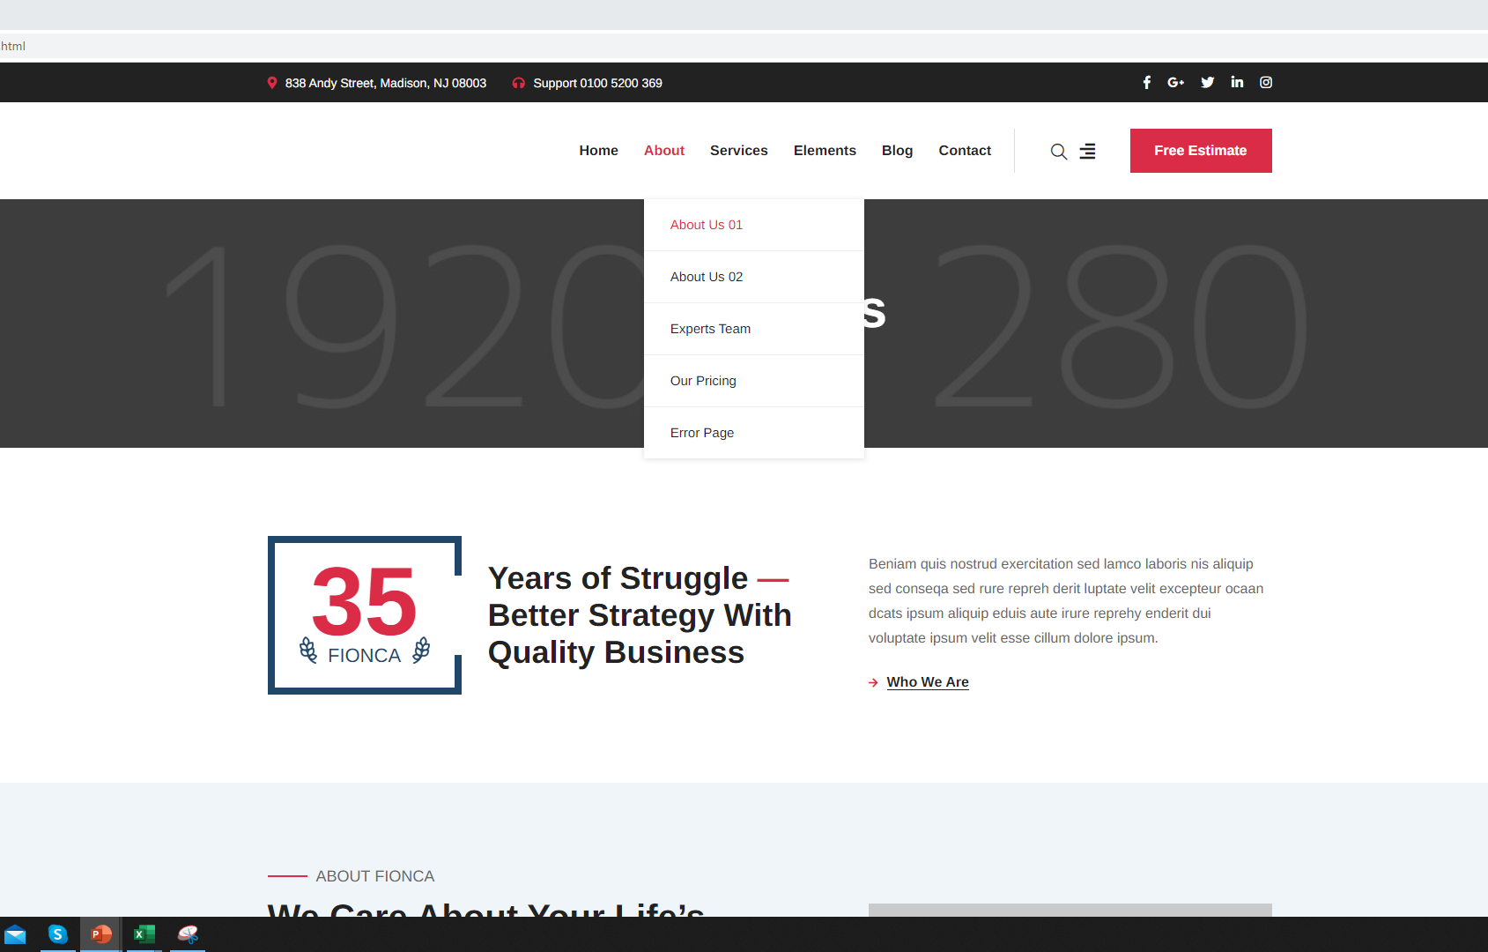
Use the About us 01 menu contents

Slide 3
Banner

Slide 4

Insert the banner template as shown (ill Insert the picture)

Slide 5
Intro Text

Slide 6
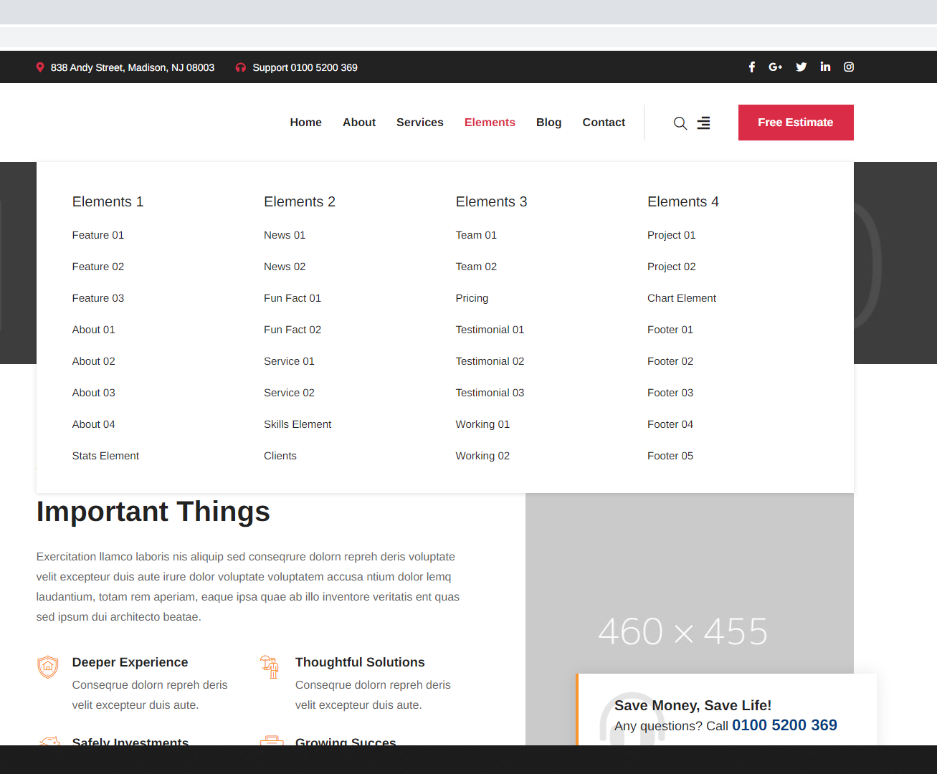

Slide 7

Insert about us text as shown

Slide 8
Video Intro

Slide 9
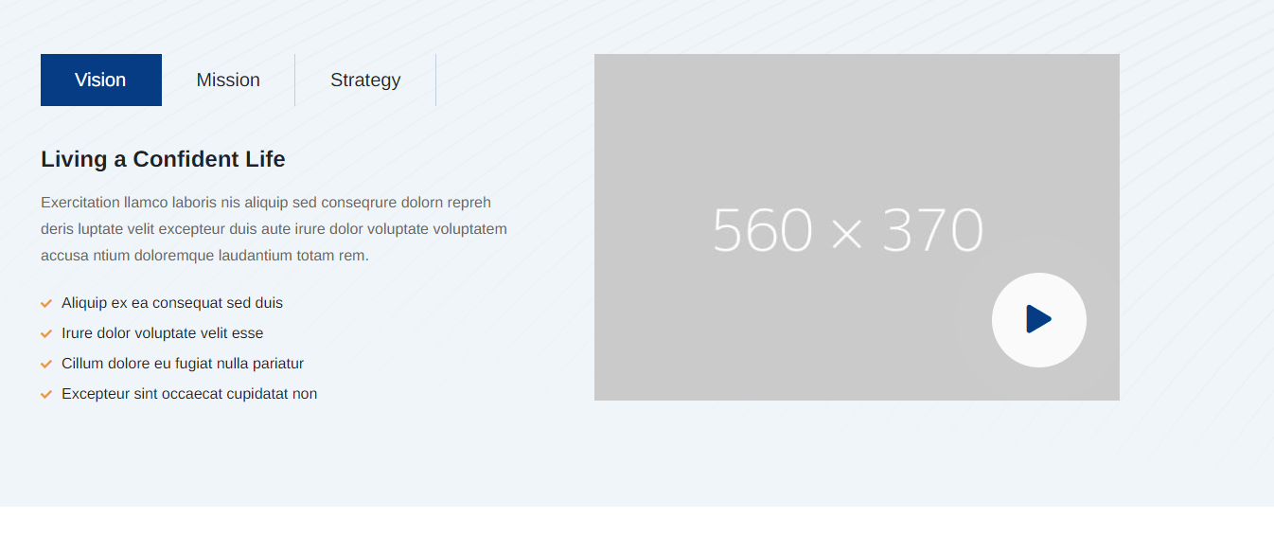
Insert the Video menu in the same format as the home page

Slide 10
Map & Stats

Slide 11
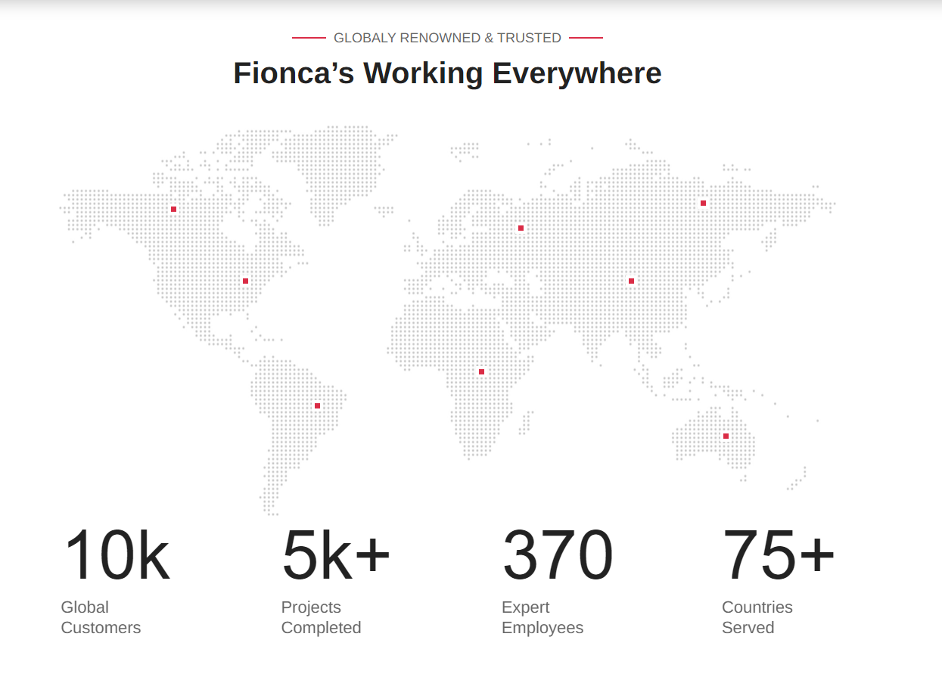

Slide 12
Our Team

Slide 13

http://preview.themeforest.net/item/brainbizz-finance-business-wordpress-theme/full_screen_preview/22835404?_ga=2.50342250.258836864.1624524424-1952668530.1593696106

Slide 14
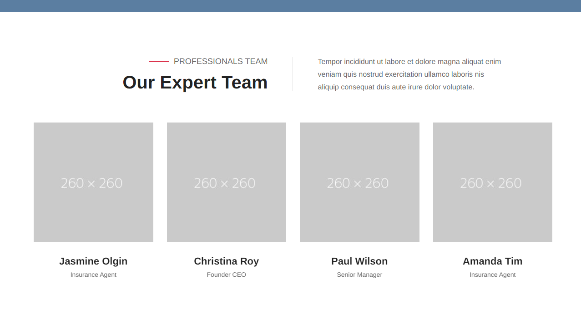

Slide 15
Contact Bar

Slide 16

Add the contact bar as found on the first home page

Slide 17
Pricing

Slide 18
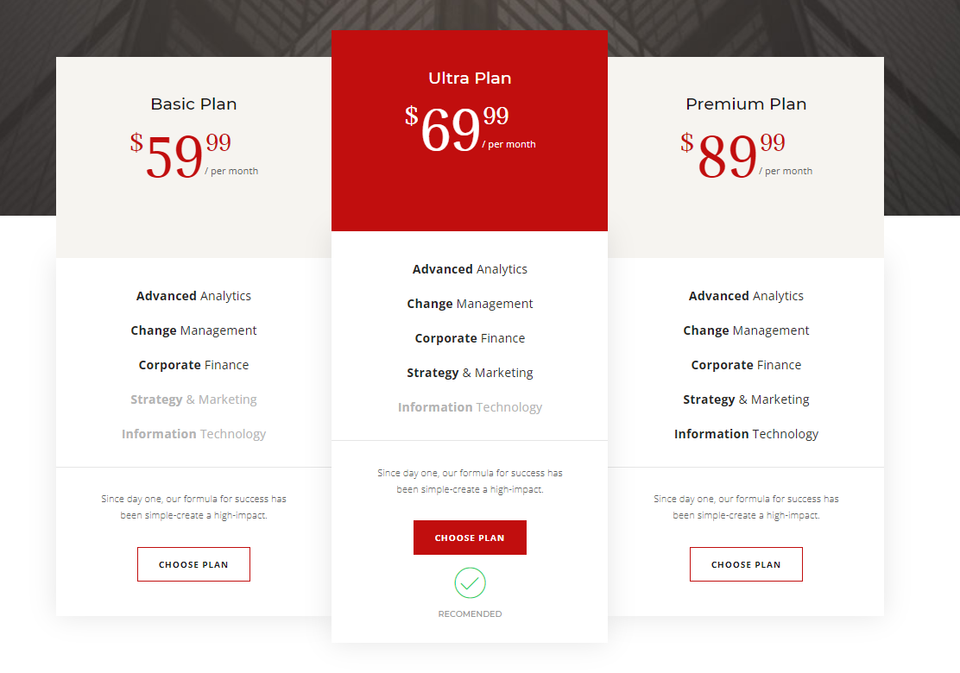
Insert the pricing template from the SPA website template, Ill edit it.
http://preview.themeforest.net/item/brainbizz-finance-business-wordpress-theme/full_screen_preview/22835404?_ga=2.50342250.258836864.1624524424-1952668530.1593696106

Slide 19
Footer

Slide 20

Keep same Footer

